Slide 1
Network Intrusion Detection on NSL-KDD Dataset
Subtitle: Leveraging Feature Selection & Machine Learning for Enhanced Network Security
Presenter by:
Charan Reddy katta (ck366)
Aakash Siricilla (as4592)

Slide 2
Introduction
Context:
Modern networks face constant threats from cyber-attacks: DoS, probing, unauthorized access (R2L), and user-to-root (U2R).
Challenge:
Traditional security measures struggle with novel attack patterns and subtle anomalies.
Goal:
Use machine learning techniques (feature selection + classification) to detect intrusions in network traffic, improving Intrusion Detection Systems (IDS).

Slide 3
The NSL-KDD Dataset
What is NSL-KDD?
Benchmark dataset derived from KDD Cup 1999.
Diverse network connections labeled as normal or various attack types.
Why NSL-KDD?
Removes redundant records for better evaluation.
Includes attacks like DoS, Probe, R2L, U2R.

Slide 4
Attack Categories:
DoS: Flooding a network resource (e.g., SYN flood).
Probe: Scanning to find vulnerabilities.
R2L: Unauthorized remote access.
U2R: Gaining root privileges.

Slide 5
Preprocessing Network Data:
Categorical to Numerical:
One-Hot Encoding for protocol (TCP, UDP, ICMP) and service types.
Aligning Train & Test Sets:
Ensure identical feature sets.
Label Mapping:
Map complex attack names to numeric codes (e.g., 0=Normal, 1=DoS).
Scaling Features:
Standardize feature values to improve model learning.

Slide 6
Feature Selection for Network Intrusion Detection
Why Feature Selection?
Reduces data volume, speeds up detection, and lowers resource usage.
Methods Used:
Univariate Selection (ANOVA F-test): Top 10% of features.
Recursive Feature Elimination (RFE): Focus on 13 key features.
Key Features Identified:
Examples: same_srv_rate, service_ecr_i.

Slide 7
Evaluation Metrics in a Network Context
Metrics Used:
Confusion Matrix: True positives vs. false negatives.
Precision: Accuracy of raised alerts.
Recall: Proportion of attacks detected.
F1-Score: Balance of precision and recall.
ROC & AUC: Model’s ability to distinguish traffic types.

Slide 8
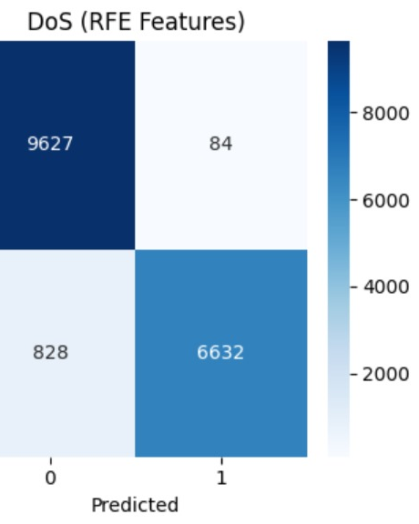
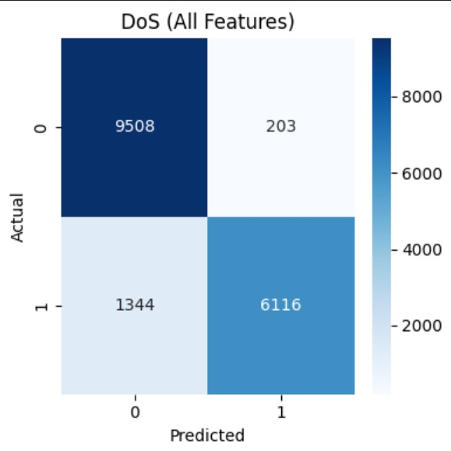

Slide 9
Visualizations & Results
Confusion Matrices:
RFE features yield fewer false alarms.
Performance Metrics:
DoS: High accuracy and F1.
Probe: Strong detection.
R2L & U2R: Challenges in subtle attack detection.
ROC Curves:
High AUC for DoS detection.

Slide 10
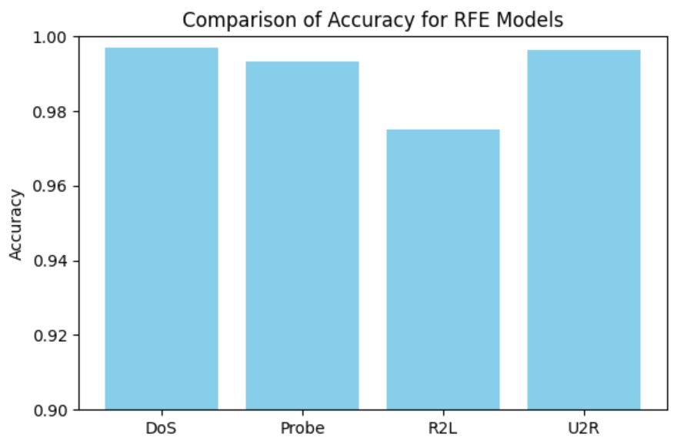
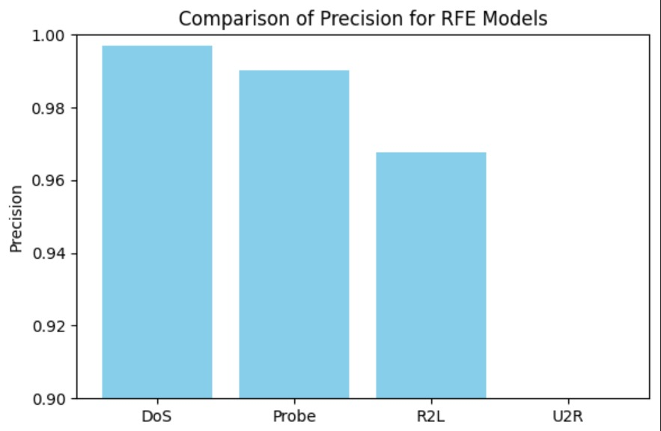
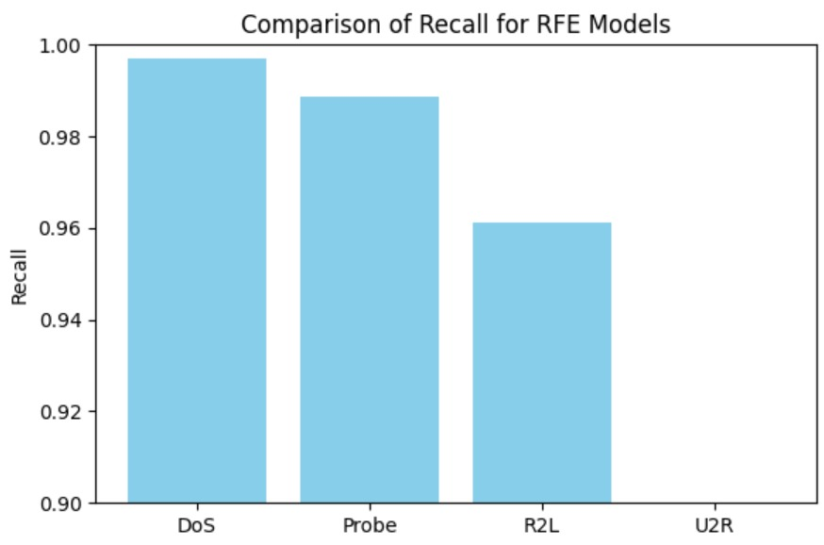

Slide 11
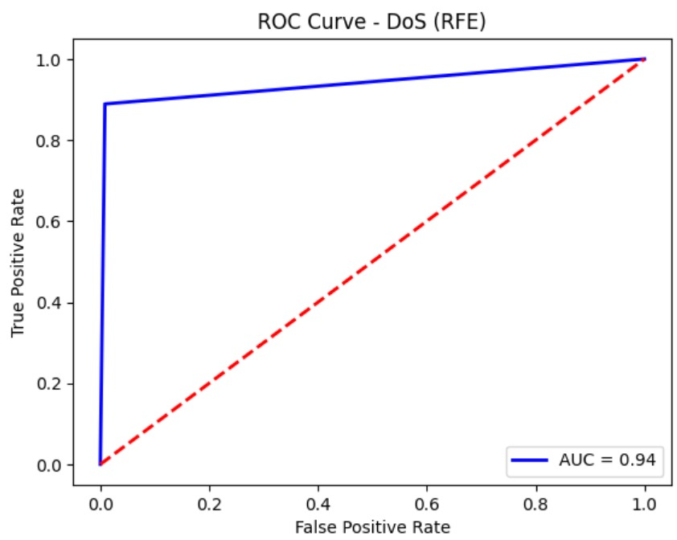
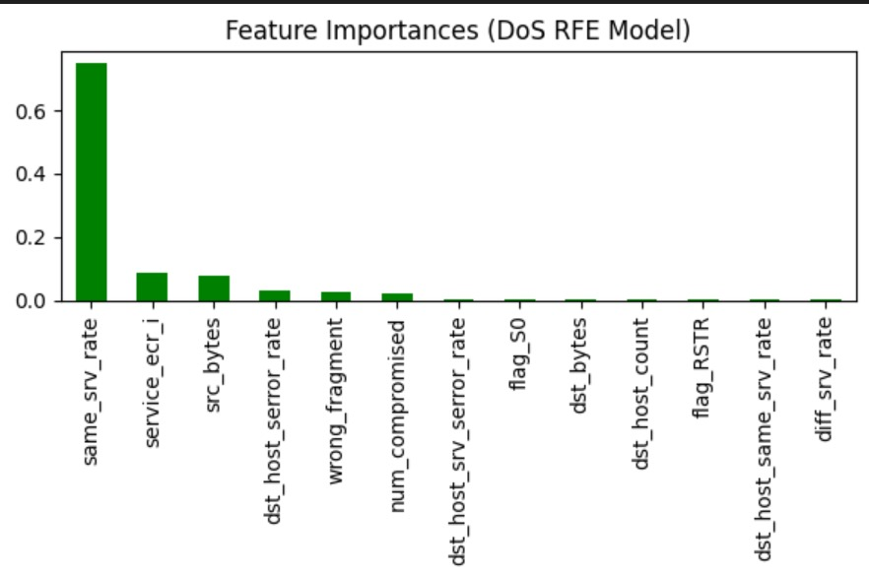
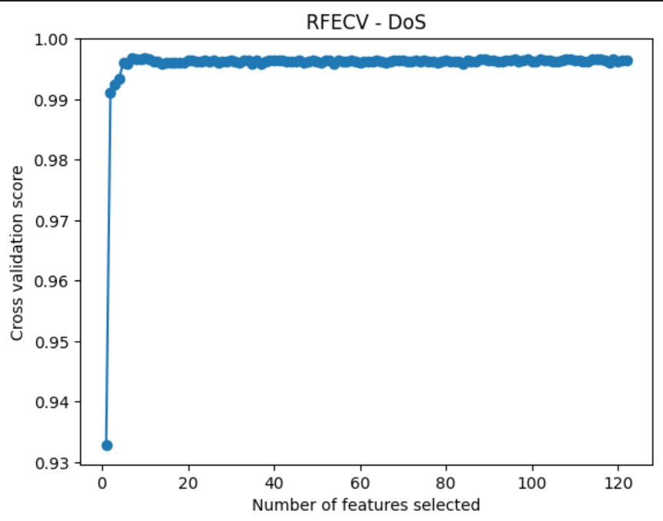

Slide 12
Key Insights
Efficient Intrusion Detection:
Reduced features maintain performance.
Reliable DoS & Probe Detection:
Systems can block malicious IPs quickly.
Challenges with R2L & U2R:
Stealthy attacks need advanced methods or better features.

Slide 13
Future Directions for Network Security
Advanced Algorithms:
Ensemble methods (Random Forest, XGBoost) or deep learning (LSTM).
Unsupervised Anomaly Detection:
One-Class SVM, Isolation Forest.
Real-Time Systems:
Test model speed and scalability in live networks.
Continuous Learning:
Online learning for evolving threats.

Slide 14
Conclusion:
Summary:
Built an ML pipeline: preprocessing, feature selection, training, evaluation.
Demonstrated efficient detection with fewer features.
Visualized results for clear communication.

Slide 15

Take-Home Message:
ML enhances IDS, enabling efficient and accurate detection of network intrusions.

